Slide 1
ARITHMETICAL
REASONING

Slide 2
Venn diagram-based problems:
Venn, a British mathematician, developed what are called Venn diagrams mainly to illustrate the principles of Set Theory and certain operations on sets.
This type of diagram is extensively used in scientific and engineering presentations, in theoretical Mathematics, in Computer applications and in Statistics.
In general, Venn Diagrams are logical diagrams, in which various items and their relationships are represented by circles or other types of diagrams.
In these questions, you will be presented with different classes or groups of familiar objects and you will be asked to identify their mutual relationships.
This requires a logical understanding and careful observation of diagrams.
The following Applications will explain the different types of questions under this category.

Slide 3
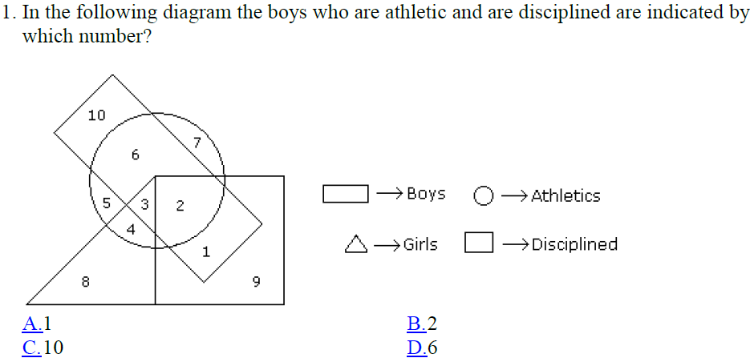
Logical Venn diagrams:

Slide 4
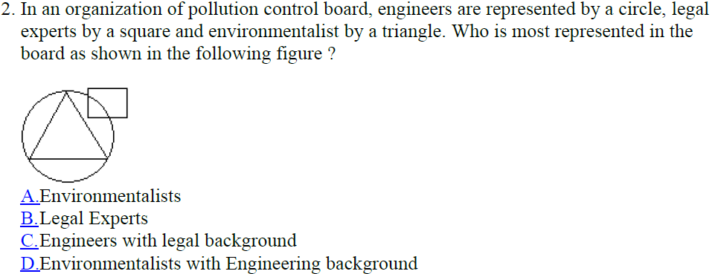

Slide 5
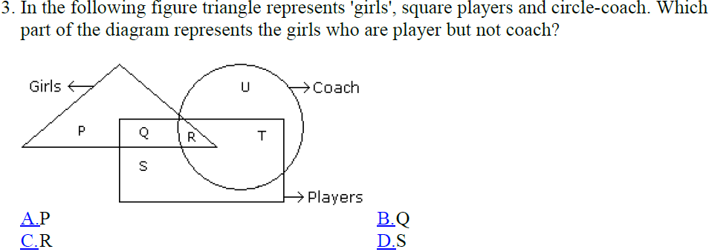

Slide 6
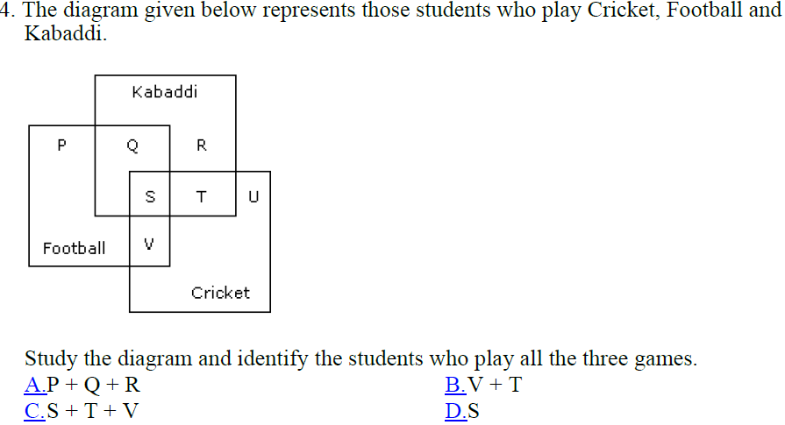

Slide 7
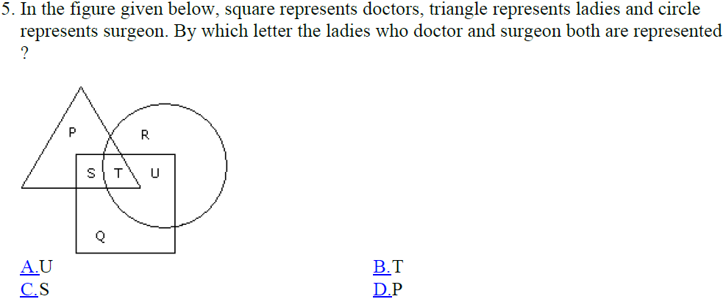

Slide 8
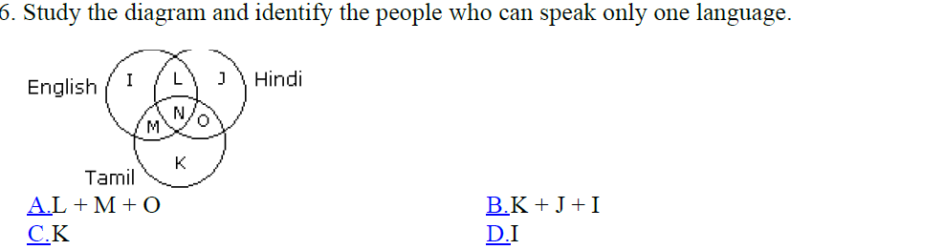
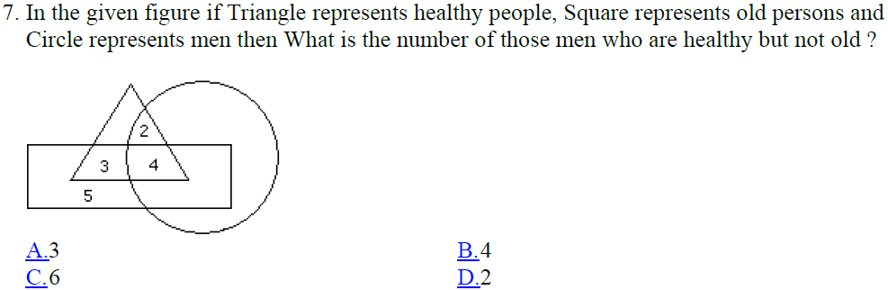

Slide 9
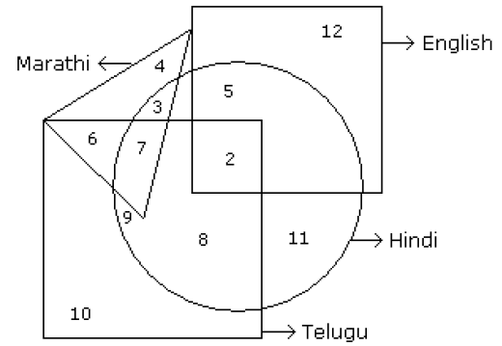

Answer from the following figure:

Slide 10





Slide 11
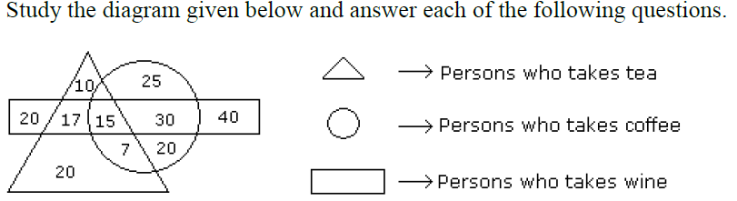
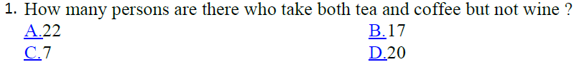
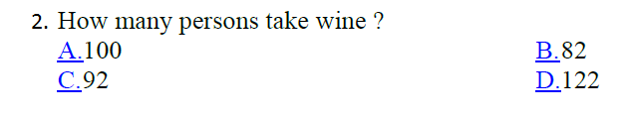

Slide 12
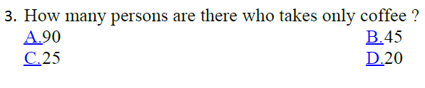


Slide 13
Practice
questions

Slide 14
In a survey, it was found that 65% of the people would watch news on TV, 40% read in newspaper, 25% read newspaper and watched TV. What percentage of people neither watched TV nor read newspaper?
0%
5%
10%
20%

Slide 15
In a class, 20 opted for Physics, 17 for Math's, 5 for both and 10 for other subjects. The class contains how many students?
35
42
52
60

Slide 16
3. In a competition, a school awarded medals in different categories. 36 medals in dance, 12 medals in dramatics and 18 medals in music. If these medals went to a total of 45 persons and only 4 persons got medals in all the three categories, how many received medals in exactly two of these categories?
12
13
14
15

Slide 17
4. In a class of 50 students, 18 take Chorus, 26 take Band, and 2 take both Chorus and Band. How many students in the class are not enrolled in either Chorus or Band?
12
4
8
6

Slide 18
A veterinarian surveys 26 of his patrons. He discovers that 14 have dogs, 10 have cats, and 5 have fish. Four have dogs and cats, 3 have dogs and fish, and one has a cat and fish. If no one has all three kinds of pets, how many patrons have none of these pets?
6
0
5
3

Slide 19
NUMBER RANKING

Slide 20
In this chapter, generally we will deal two types of questions. They are based on:
Number test
Ranking test
In this chapter, we deal with questions which are followed with a sequence consisting numbers, and ranking
We have to find answers on the basis of given condition.
The importance of such types of questions cannot be over-emphasized as their presence in a test of reasoning is almost certain.
Though no explanations are required as how to attempt these questions in exams.

Slide 21
Number Test:
In this type of questions, generally a set , group or series of numerals is given and the candidate is asked to trace out numerals following certain given conditions or lying at specific mentioned positions after shuffling according to a certain given pattern.

Slide 22
1. How many 4's are there preceded by 7 but not followed by 3?
5 9 3 2 1 7 4 2 6 9 7 4 6 1 3 2 8 7 4 1 3 8 3 2 5 6 7 4 3 9 5 8 2 0 1 8 7 4 6 3
a) 3
b) 4
c) 5
d) 6

Slide 23
2. How many 5s are there in the following number sequence which are immediately preceded by 7 and immediately followed by 6?
Terms : 7 5 5 9 4 5 7 6 4 5 9 8 7 5 6 7 6 4 3 2 5 6 7 8
(a) 1
(b) 2
(c) 3
(d) 4

Slide 24
3. How many even numbers are there in the following series of numbers, each of which is immediately preceded by an odd number, but not immediately followed by an even number?
Terms : 5 3 4 8 9 7 1 6 5 3 2 9 8 7 3 5
(a) Nil
(b) 1
(c) 2
(d) 3

Slide 25
Direction for Q4 and Q5:
Following questions are based on the five three-digit numbers given below
5 1 9 3 6 4 2 8 7 1 5 8 8 3 5
4. If the positions of the first and the third digit within each number are interchanged, which of the following will be the third digit of the second lowest number?
(a) 9
(b) 4
(c) 7
(d) 8

Slide 26
5 1 9 3 6 4 2 8 7 1 5 8 8 3 5
5. Which of the following is the difference between the second digit of the lowest and the highest of these numbers?
(a) 3
(b) 1
(c) 2
(d) 0

Slide 27
6. If it is possible to form a number which is a perfect square of a two digit odd number using the second, fourth, seventh digits of the number 739142658 using each only once, which of the following is the second digit of that two-digit odd number?
a) 4
b) 7
c) 3
d) None

Slide 28
7. The positions of the first and sixth digits in the number 5109238674 are interchanged. Similarly the positions of the second and the seventh digits are interchanged and so on . which of the following will be the third digit from the right end after the after the rearrangement?
a) 9
b) 0
c) 6
d) 3

Slide 29
8. How many such digits are there in the number 7346285 which are as far away from the beginning of the number, as they will be when arranged in ascending order within the number?
a) None
b) One
c) Two
d) Three

Slide 30
9. How many numbers amogst the numbers 9 to 54 are there which are exactly divisible by 9 but not by 3 ?
a) 5
b) 6
c) 0
d) 9

Slide 31
Ranking Test:
There are many different types of questions that are asked from the order and ranking topic. Those questions are generally related to rank from the left, right, top, and bottom, the total number of persons, products or elements, etc. Thus, many different types of questions can be formed based on the position or the rank of the persons, things, or products. In this topic, we will discuss how the concepts of Order and Ranking works. Let us understand, it with the help of the important rules:

Slide 32
Rule No 1:
To find the total number of persons/things of a single row, when ranks of one person/things is/are given from both sides of the row.
Formula: Total number of persons/things = Rank from Left end + Rank from Right end – 1
Example:
In a row of girls, the position of Radhika is 38th from the left side of the row, and the position from the right side of the row is 19th. Find the total number of girls in that row.
Solution: Total no. of person= (The position of Radhika from the left end + the position of Radhika from the right end) – 1
Therefore, the total no. of person is = (38 + 19) – 1= 57 – 1 = 56
Hence, the total number of girls in that row is 56.

Slide 33
Rule No. 2:
To find the rank or position of a person/thing from the opposite side, when rank or position from one side and total number of persons/things are given.
Formula: Position of a person from the opposite ends= (Total number of persons of that row – Position of the same person/thing from the given side) + 1
Example:
In a row of 31 persons, the position of Vicky from the left side of the row is 8th. What is the position of Vicky from the right side of that row?
Solution:
The position of Vicky from the right side is = (The total number of persons of that row – Position of Vicky from the left side) +1 = (31-8) + 1 = 24

Slide 34
Rule No. 3:
To find the number of persons/things after or before a person/thing whose rank from another side is given –
Number of persons/things after or before the given person/thing in a row = Total no. of persons/things – Position of the same person/thing from another side
Example:
In a billing line of 32 persons, the position of Hafiz from the front side of the row is 14th. Find the number of persons after Hafiz in that row?
Solution:
Number of persons after Hafiz = Total number of persons – Position of Hafiz from the front side
⇒ Number of persons after Hafiz in the row = 32 – 14 = 18
Hence, 18 persons are there after Hafiz in that row.

Slide 35
Rule No. 4:
To find the total number of persons/things in a row, when ranks of two persons/things and number of the persons/things who are sitting between those two persons/things are given.
In, such cases there will be two possible type:-
A. Case of Overlapping:
When the number of persons/things –> (position of a person/thing from the right side + position of another person/thing from the left side) is greater than the total number of persons/things
Number of persons between them = (Sum of positions of two different persons/things from both sides) – (Total number of persons/things) – 2
Example:
In a row of 22 boys. Ronak is 26th from the left side of the row and Shanky is 9th from the right side of the row. Find out the number of persons sitting between them?
Solution:
Number of persons between Ronak and Shanky = (26+9)-22-2= 35-22-2 = 11
Hence, the number of persons sitting between them is 11.

Slide 36
B. Case of not overlapping:
When Total number of persons/things is greater than the (position of one person from the right side /thing + position of another person/thing from the left side).
Number of persons between two persons/articles = Total number of persons/articles – (Sum of positions of two different persons/articles from both sides)
Example:
In a row of 85 persons. Manya is 24th from the left side of the row and Rashi is 19th from the right side of the row. Find out the number of persons sitting between them?
Solution:
Number of persons between Manya and Rashi = 85 – (24+19) = 85-43 = 42
Hence, there are 42 persons between Manya and Rashi.

Slide 37
Rule No. 5:
When in a single row, the positions of two persons are given and their positions are interchanged and after interchanging the position of first person is given from the same side as before interchanging.
a) To find the total number of persons of that row:
Formula:
Total Number of persons = Sum of the particular positions of a place (different person) from both sides – 1

Slide 38
Example:
In a row of persons, Ashish is 11th from the left and Salman is 20th from the right. If they interchange their positions, then Ashish becomes 17th from the left. Find out the total number of persons of that row.
Solution:
Total Number of persons = Sum of the particular positions of a place (different person) from both sides – 1
Positions of Salman before change + position of Ashish after change – 1
20 + 17 – 1 = 36
Hence, there are 36 persons.

Slide 39
b) To find the new position of the second person from the same side as before interchanging:
Formula: The position of the second person from the same side as before interchanging = The position of the second person from the same side before interchanging + (position of the first person after interchanging – position of the first person before interchanging from the same side
Example:
In a row of persons, Ashish is 11th from the left and Salman is 20th from the right. If they interchange their positions, then Ashish becomes 17th from the left. Then, what will be the new position of Salman from the right end?
Solution: Total no of persons in a row = Position from the right end + Position from the left end – 1
= 20 + 17 – 1 = 35
Salman’s position from right end = Total persons – Ashish’s position from the left end + 1
= 36 – 10 + 1 = 27
Hence, in the new arrangement, the position of Salman is 27th from the right end.

Slide 40
c) To find the number of persons between that two persons:
Formula:
Number of persons between two persons = Difference in the positions of a person (same person) whose position from same side before and after interchanging is given – 1
Example:
In a row, Avni is 14th from the left end and Tanmay is 13th from the right end of the row. If they interchanged their positions Avni becomes 19th from the left end. Find the number of persons between them.
Solution:
Number of persons between Avni & Tanmay = (Position of Avni from left after interchanging– Position of Avni from left before interchanging) – 1
⇒ Number of persons between Avni & Tanmay is = (19 – 14) – 1 = 5 – 1 = 4

Slide 41
Rule No. 6:
In a row, if the positions of two different persons are given from opposite sides of the row and a third person is sitting exactly in the middle of that two person. If total number of persons is to be calculated, then there are will be two conditions –
a) When the position of the third person is to the left side of that person whose position was given from the right side. Or when the position of the third person is to the right side of that person whose position was given from the left side.
b) When the position of the third person is to the left side of that person whose position was given from the left side. Or when the position of the third person is to the right side of that person whose position was given from the right side.

Slide 42
Example:
In a row there are some persons, the position of Nishant from the left side of the row is 16th and position of Shikha from the right side of the row is 11th. If Mahesh is sitting just in the middle of Nishant and Shikha and there are two persons between Mahesh and Nishant. Find the total number of persons in the row?
Solution:
A) If Mahesh is to the left of Shikha, then the number of persons in the row will be:
Shortcut Rules:
⇒ Position of 1st person+ Position of 2nd person + twice of the number of people between the third person and any of them (which was given) + 1
⇒ Position of Nishant + Position of Shikha + twice of the number of people between the third person and any of them (which was given) + 1
⇒ 16 + 11 + (2 × 2) + 1 = 32

Slide 43
B) If Mahesh is to the right of Shikha, then the number of persons in the row will be:
Shortcut Rules:
⇒ Position of 1st person+ Position of 2nd person + twice of the number of people between the third person and any of them (which was given) – 3
⇒ Position of Nishant + Position of Shikha – twice of the number of people between the third person and any of them (which was given) – 3
⇒ 16 + 11 – (2 × 2) – 3 = 20

Slide 44
Practice
questions

Slide 45
In a row of boys, If A who is 10th from the left and B who is 9th from the right interchange their positions, A becomes 15th from the left. How many boys are there in the row ?
a) 23
b) 31
c) 27
d) 28
Ans: a

Slide 46
2. Nitin ranks 18th in a class of 49 students. What is rank from the last ?
a) 18
b) 19
c) 31
d) 32
Ans: d

Slide 47
3. A class of boys stands in a single line, One boy is 19th in order from both the ends, How many boys are there in the class ?
a) 36
b) 37
c) 38
d) 39
Ans: b

Slide 48
4. A class of boys stands in a single line. One boy is nineteenth in order from both the ends. How many boys are there in the class?
(a) 27
(b) 37
(c) 38
(d) 39
Ans: b

Slide 49
5. Anu and Vinay are ranked seventh and eleventh respectively from the top in a class of 31 students. What will be their respective ranks from the bottom in the class?
(a) 20th and 24th
(b) 24th and 20th
(c) 25th and 21st
(d) None of these
Ans: C

Slide 50
6. In a class of 42 students, Mahesh’s rank is 16th from the bottom. What is his rank from the top?
(a) 25th
(b) 26th
(c) 24th
(d) 27th
Ans: d

Slide 51
7. In a row of boys, A is 13th from the left and D is 17th from the right. If in this row A is 11th from the right then what is the positions of D from the left?
a) 6th
b) 7th
c) 10th
d) 14th
Ans: B

Slide 52
8. In a row of thirty boys, R is fourth from the right end and W is tenth from the left end . How many boys are there between R and W?
(a) 15
(b) 16
(c) 17
(d) Cannot be determined
Ans: b

Slide 53
9. There are five books of different thickness. A is thicker than C and B is thicker than D. E is not as thick as B, but is thicker than C. D is not as thick as C. Which is the thinnest book?
(a) E
(b) D
(c) B
(d) C
Ans: b

Slide 54
10. In a class of 180, where girls are twice the number of boys, Rupesh [a boy] ranked 34th from the top. If there are 18 girls ahead of Rupesh, how many boys are after him in rank?
(a) 45
(b) 44
(c) 60
(d) Cannot be determined

Slide 55


